Slide 1

Dawood University Department of Cyber Security Section A2 Pakistan Studies
Foreign Policy of Pakistan
Students
25F-CY-065 M Nabeel
25F-CY-094 M Arif 25F-CY-096 Syed Usman
Teacher Name: Faisal

Slide 2

What is Foreign Policy?
Foreign policy is a set of strategies and decisions through which a country manages its relations with other countries. It includes political, economic, military, and diplomatic interactions. It helps a country protect its national interests, ensure security, and promote development. Example: Trade agreements, peace talks, and defense cooperation are all part of foreign policy.

Slide 3
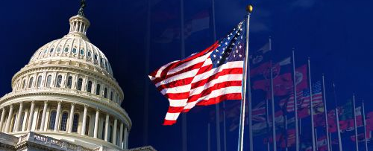
Overview of Pakistan’s Foreign Policy
Pakistan’s foreign policy is based on peaceful coexistence, mutual respect, and cooperation. It aims to maintain strong relations with neighboring countries and major global powers. Pakistan also tries to balance relations between powerful countries like China and United States. It focuses on regional peace, economic development, and national security.

Slide 4
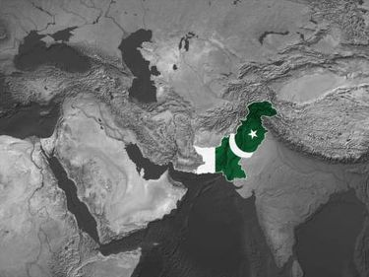
Objectives of Pakistan’s Foreign Policy

Slide 5

National Security
Protect the country from external threats
Maintain a strong defense system
Address conflicts such as with India
Ensure safety of borders and citizens

Slide 6

Economic Development
Increase exports and improve trade relations Attract foreign investment (like CPEC projects) Build economic partnerships with developed countries Strengthen industries and reduce poverty

Slide 7

Protection of Sovereignty
Maintain independence in decision-making Avoid foreign interference in internal matters Protect national identity and dignity

Slide 8
Promotion of Peace
Avoid wars and conflicts
Promote dialogue and negotiations
Support peaceful resolution of disputes

Slide 9
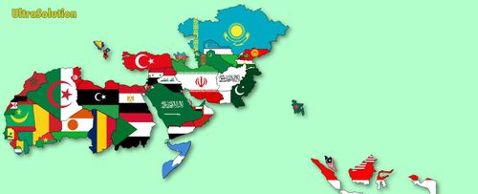
Support for Muslim Countries
Strengthen unity among Islamic nations
Raise voice for Muslim issues internationally
Active participation in Organization of Islamic Cooperation

Slide 10
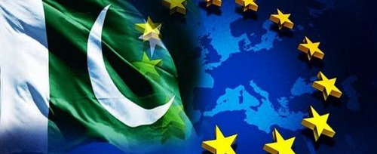
Principles of Pakistan’s Foreign Policy
Respect for international law
Non-interference in internal affairs of other states
Peaceful coexistence
Mutual cooperation and benefit
Support for global peace and justice

Slide 11
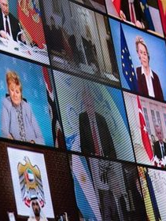
Importance of Foreign Policy
Improves Pakistan’s global image
Promotes trade and economic growth
Helps build alliances and partnerships
Helps resolve international conflicts peacefully
Strengthens national security

Slide 12
Pakistan’s Foreign Relations
Pakistan maintains relations with many countries based on political, economic, and strategic interests.
These relations help Pakistan gain support, trade opportunities, and security cooperation.

Slide 13
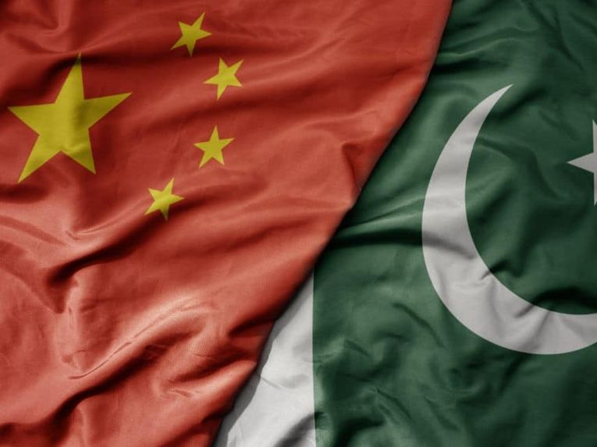
Relations with China
China is Pakistan’s closest and most trusted ally
Cooperation in defense, technology, and infrastructure
Major project: China-Pakistan Economic Corridor (CPEC)
China supports Pakistan on international platforms

Slide 14
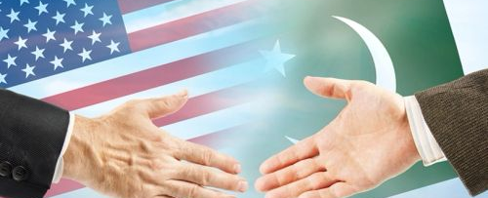
Relations with United States
USA is a global superpower
Pakistan cooperated in the War on Terror
Received military and economic aid
Relationship has trust issues and fluctuations

Slide 15
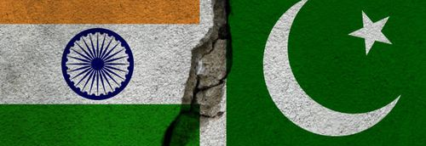
Relations with India
Most challenging relationship
Main issue: Kashmir dispute
History of wars (1948, 1965, 1971)
Frequent tensions and ceasefire violations

Slide 16
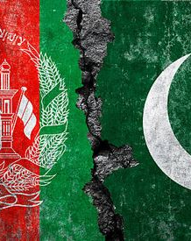
Relations with Afghanistan
Important neighboring country
Issues: border security, terrorism, refugee crisis
Stability in Afghanistan directly affects Pakistan

Slide 17
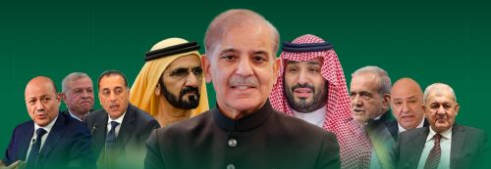
Relations with Middle Eastern Countries
Strong religious and cultural ties
Countries like Saudi Arabia and UAE are key partners
Provide oil and employment opportunities
Pakistan supports them diplomatically

Slide 18
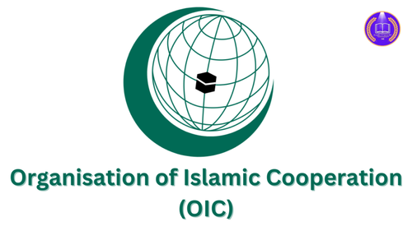
Role in International Organizations
Active member of United Nations
Participates in peacekeeping missions
Member of Organization of Islamic Cooperation

Slide 19
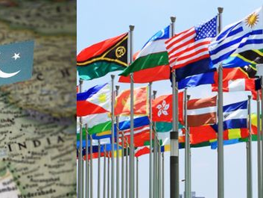
Challenges of Pakistan’s Foreign Policy

Slide 20

Political Instability
Frequent changes in government
Lack of long-term policies
Weak leadership affects international trust

Slide 21

Economic Problems
Low GDP growth
Heavy debt and reliance on IMF
Trade imbalance (more imports than exports)
Weak currency

Slide 22
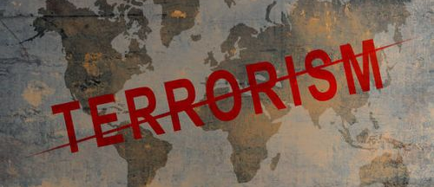
Security Issues
Terrorism and extremism
Internal instability
Border tensions

Slide 23
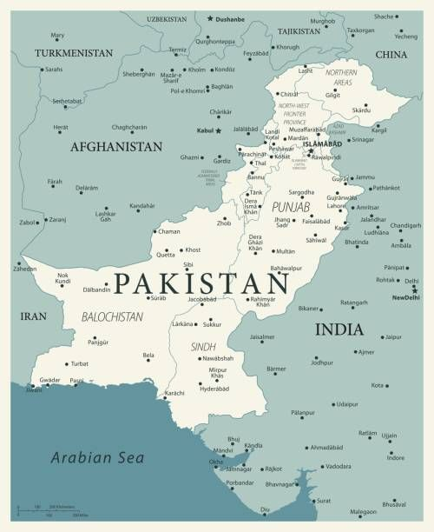
Relations with Neighbors
Conflict with India
Issues with Afghanistan
Regional instability

Slide 24
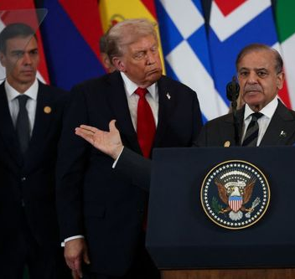
Global Pressure
Influence of powerful countries like USA and China
Need to balance relationships
Pressure on defense and economic decisions

Slide 25
Dependence on Foreign Aid
Reliance on loans and international support
Limits independent foreign policy decisions

Slide 26

Negative Global Image
Due to terrorism and instability
Reduces foreign investment
Affects tourism and diplomacy

Slide 27

Energy Crisis
Heavy dependence on imported oil
Economic burden
Impacts relations with oil-producing countries

Slide 28
Climate and Environmental Challenges
Floods and climate disasters
Need for global cooperation
Affects foreign aid and international relations

Slide 29
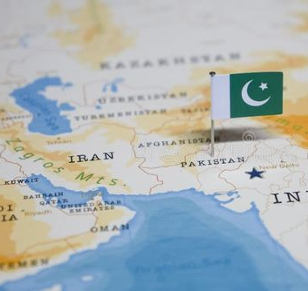
Conclusion
Foreign policy is essential for Pakistan’s security and development
Requires political stability and strong economy
Must improve relations with neighbors
Focus on peace, diplomacy, and economic growth

Slide 30
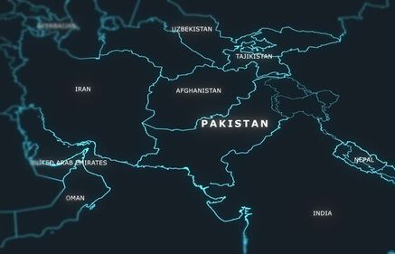
Thank you

